Slide 1


Kanban,
Workflows to optimize value to
optimize value by optimizing flow.
Notes:
Attending to the brief requirement for this task I am going to summarize the Kanban methodology though my choice is still a mystery I cannot explain entirely, yet.

Slide 2

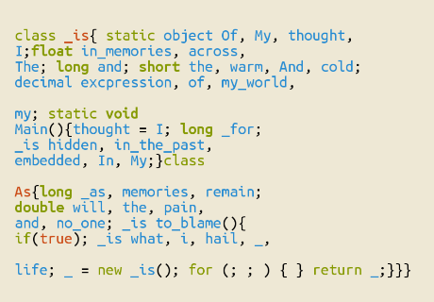
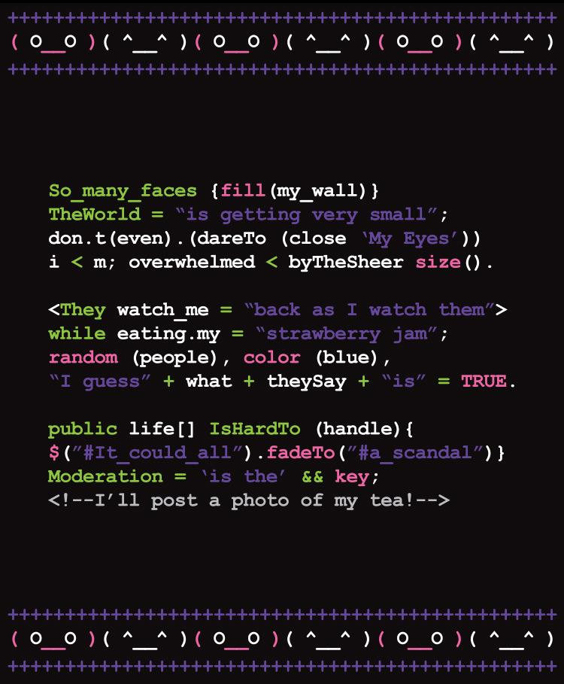
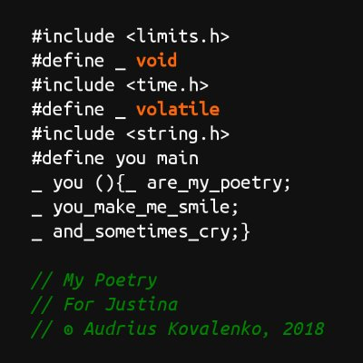
(defun the-road-not-taken (x y)
(if (= x y) (message "you're my road %s" y)
(message "I will think of you %s" y)))
Notes:
I should say that I got a bias on reading poetry, interest that swapped to coding

Slide 3

(defun the-road-not-taken (x y)
(if (= x y)
(message "you're my road %s" y)
(message "I will think of you %s" y)))
Notes:
when once learned a little about programming I used to find myself quite long whiles awestruck on the beautiful simplicity of some scripts.

Slide 4
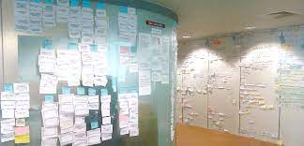
Kanban is a strategy for optimizing the flow of value through a process that uses a visual
Notes:
The same appealing reaction I got after learning that the keystone of the Kanban methodology was not that visually centred workflow tracking system everybody uses to talk about to define Kanban

Slide 5
As most workflows exist to optimize value, the strategy
of Kanban is to optimize value by optimizing flow
Defining and visualizing a workflow
Actively managing items in a workflow
Improving a workflow
Notes:
this was just a myth among others, but the insight you might get by focusing on the quest of the method which reads as it follows "from workflow to optimise value, to optimise value by optimising flow".

Slide 6
The Basic
(No) tandem (but) Triplet
DoW
Actively Managing Workflow
Improving Workflow
Notes:
Being this complexity crowded with so many concerns in action, namely customer requirements, team skills and conditions the first quest is get proper definitions, do it properly and measure it. The Kanban handbook call it the basic Tandem:

Slide 7
Define When started & Finish
WIP (Work in Progress) one or more states the work item flows from start to finish.
Define how-to control WIP
Explicit policies about how items can flow through each state
a SLE (Service level expectation) which is a forecast of how long it should take a WI to flow from started to finish
Notes:
And here is the mysterious connection. You probably will got new insights by stopping and unblocking blocked tasks

Slide 8

- Controlling WIP (Work-Items in a workflow or slots/tokens on a Kanban board).
- Avoiding W-Items piling up any part of the flow
- Ensuring work not age (tool: SLE)
- Unblocking blocked Work
Notes:
(it seems obvious but check out what is actually blocking and clean it) because solving tasks by coding is really of the same nature than crafting expressions with words, and as poetry, it depends so much on inspiration. Here creativity is a strategy.

Slide 9
Checking WIP-limits (on board)
Gain information from board (visualisation and other Kanban measures)
State the problem you are solving in one or two sentences.
Make sure to explain why it is a real problem.

Slide 10
Kanban Metrics (WIP, Through-Put: WItems finished per unit of time, WI age, Cycle Time)

Slide 11
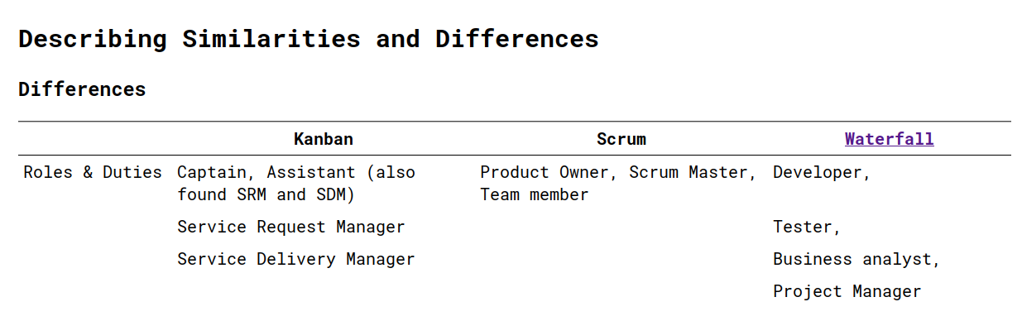

Slide 12
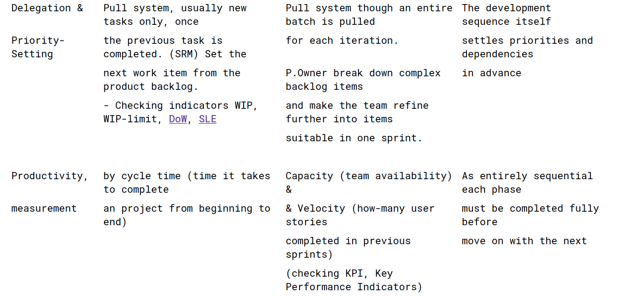

Slide 13
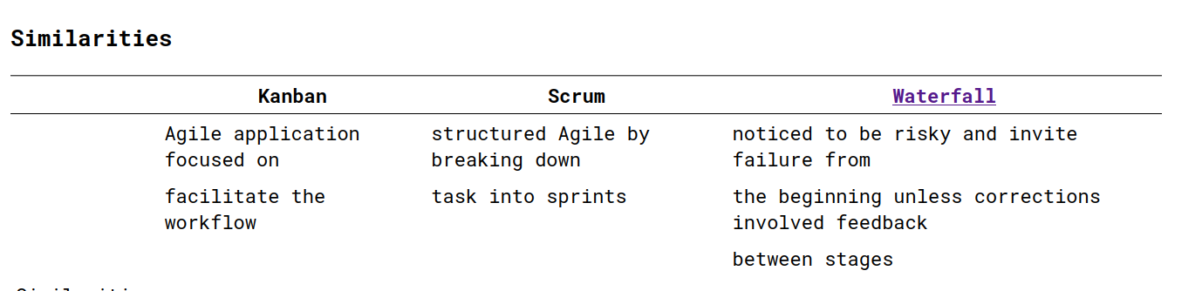
Notes:
Considering the context all methodologies all methodologies share more than diverge.

